Slide 1

ANALYSIS OF THE BANKING DATASET
Submitted By:
Sharon Blessy J V
Indian Institute Of Information Technology Tiruchirappalli

Slide 2

Contents of the Banking Dataset:
The data is related to the direct marketing campaigns of a Portuguese banking institution done through phone calls from May 2008 to November 2010.
Size of the Banking Dataset:
The dataset contains 45,217 rows and 19 columns.
Outliers in the Banking Dataset:
The marital status and education of three clients are absent.

Slide 3

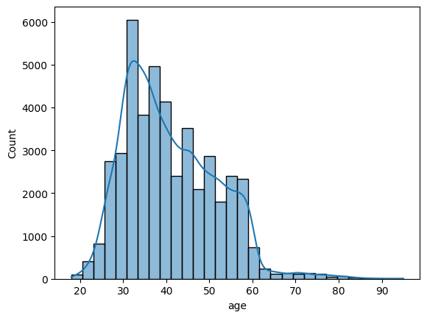
Age Distribution of Clients:
The ages of the clients range from 18 to 95.
Majority of the clients are between the ages 30 to 45.

Slide 4
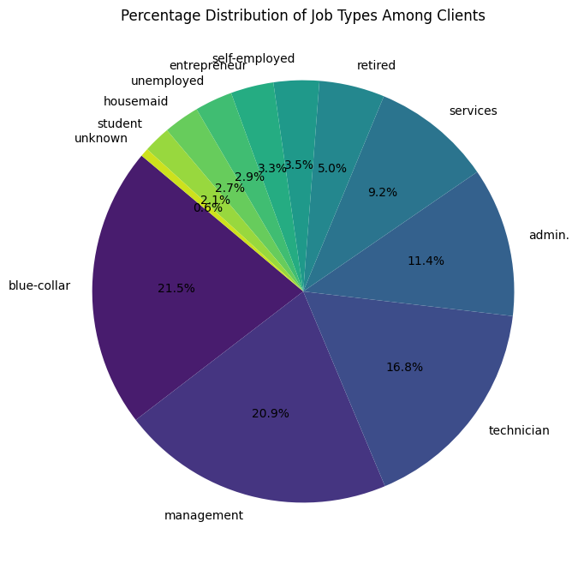
Distribution of Jobs of Clients:
The types of jobs of the clients are:
Job | Count
Blue - collar | 9732
Management | 9460
Technician | 7597
Admin. | 5171
Services | 4154
Retired | 2267
Self - Employed | 1579
Entrepreneur | 1487
Unemployed | 1303
Housemaid | 1240
Student | 938
Unknown | 288

Slide 5
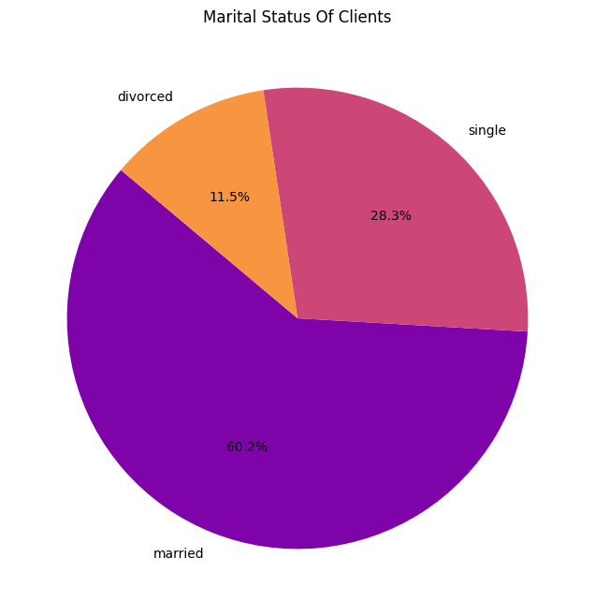
Marital Status of Clients:

Slide 6
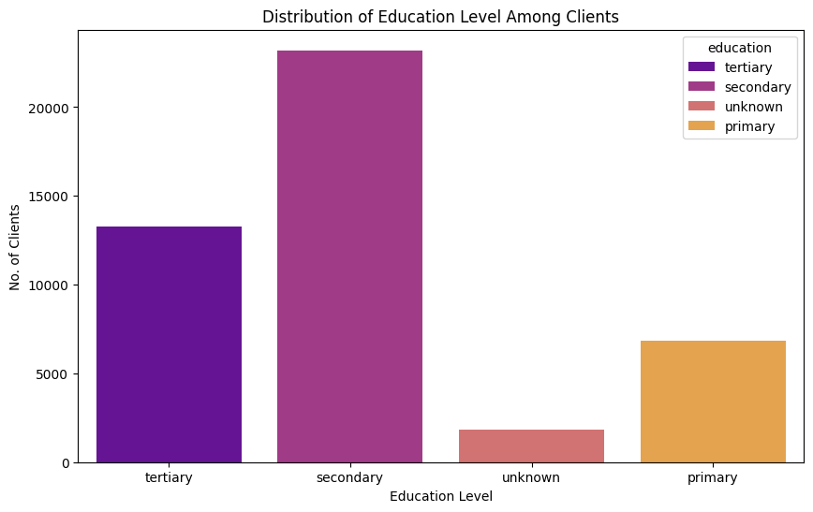
Distribution of Education level of Clients:
Most of the clients have secondary level of education.

Slide 7
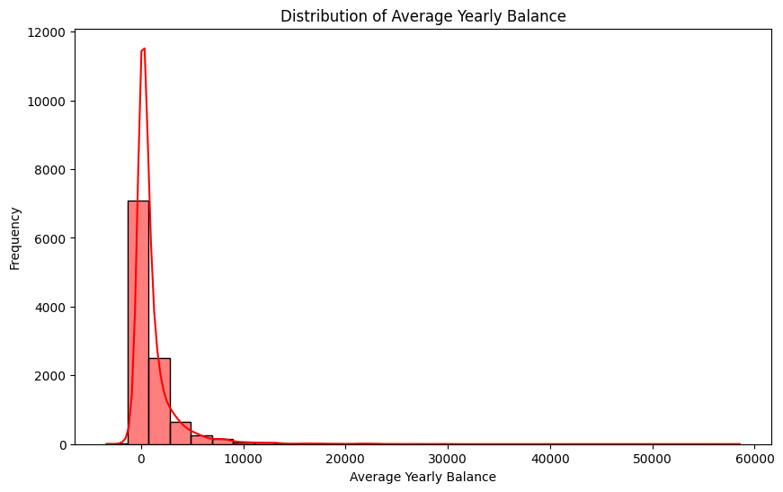
Distribution of clients with credit in default:
Around 98.19% don’t have credit in default while the remaining 1.81% have the same.
Credit in default | Count
No | 44401
Yes | 815
Average yearly balance of the clients:
The average yearly balance of clients range from -8,016€ to 102,127€.
3766 clients have negative balance .

Slide 8
Client with housing loan:
Housing loan | Count
Yes | 25130
No | 20086
Around 55.5% of clients have taken housing loan while the remaining 44.5% haven’t.
Client with personal loan:
Housing loan | Count
Yes | 25130
No | 20086
Around 83.97% of clients have not taken personal loan while the remaining 16.03% have.

Slide 9
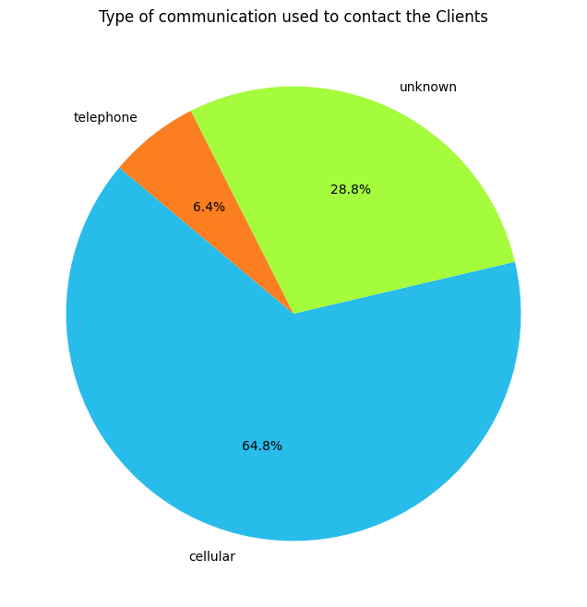
Types of communication used to contact the client:
Communication types used include cellular , telephone and some unknown methods.
Majority of the clients were contacted via cell.

Slide 10
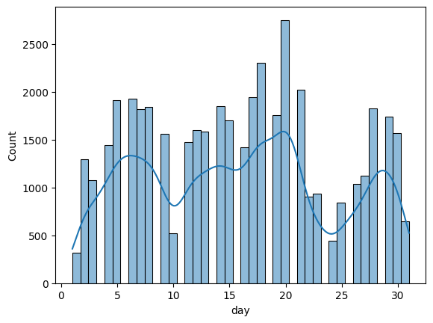
Distribution of date of last contact:

Slide 11
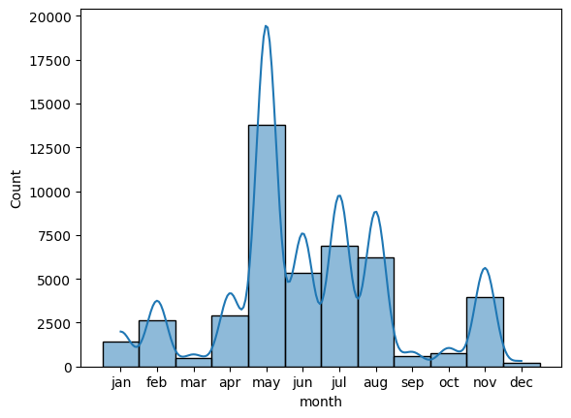
Distribution of month of last contact:

Slide 12
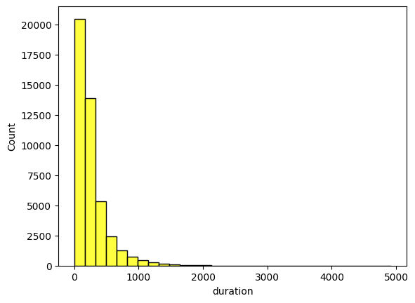
Distribution of the duration of last contact:

Slide 13
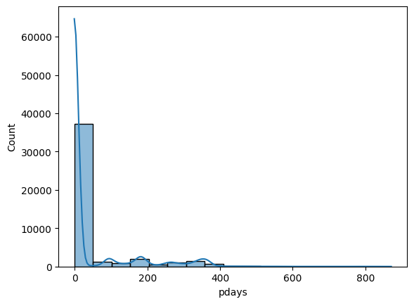
Distribution of the time since last contact:
Most clients were last contacted before 50 days.
Days since last contact vary from 0 to around 871 days.
Some of them were not previously contacted.

Slide 14
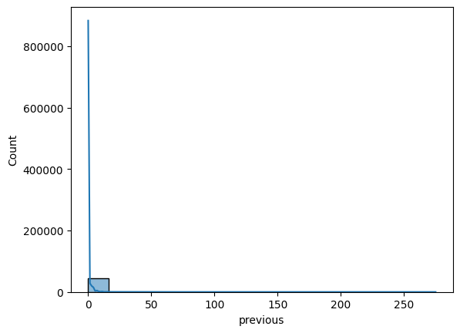
The range of the number of times clients were contacted since last campaign from 0 to 275 timed.

Slide 15
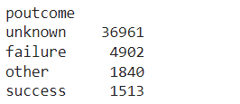
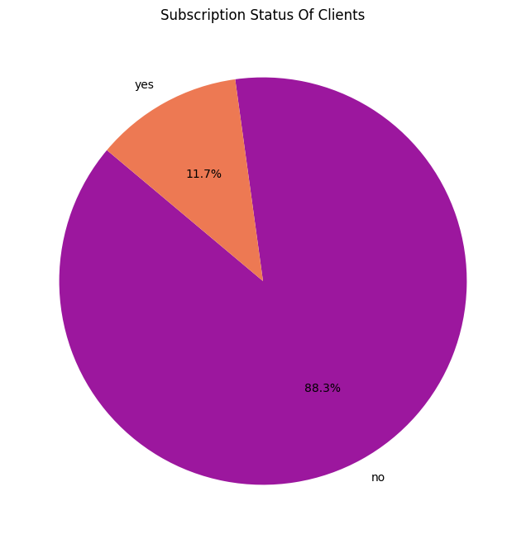
Outcomes of the previous campaign:
Outcomes of the campaign among large number of clients is unknown.
The image indicates the distribution of the outcome of the previous campaign among clients.
Term Deposit Subscription status of the clients:
Majority of the clients have not subscribed to a terms deposit while around 11.7% have subscribed.

